Slide 1

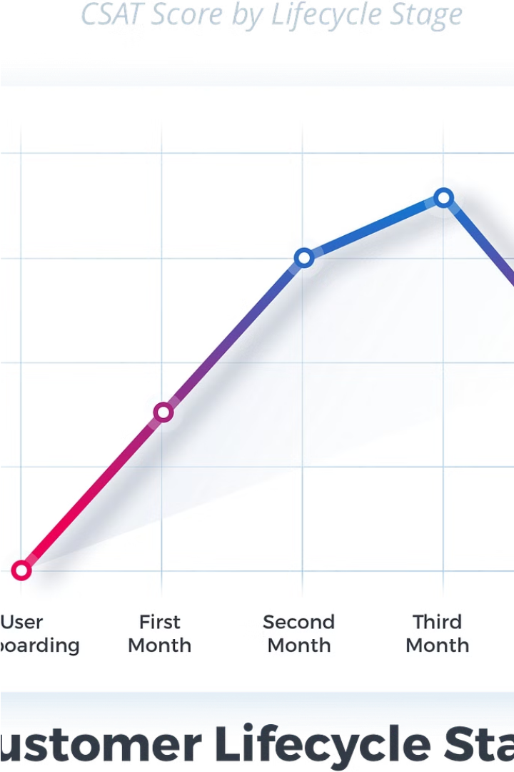

Understanding Customer Lifetime Value (CLV)
Customer Lifetime Value (CLV) is the total net revenue a company can expect from a single customer throughout their relationship. It's a crucial metric for businesses to understand and maximize.
by vinit

Slide 2
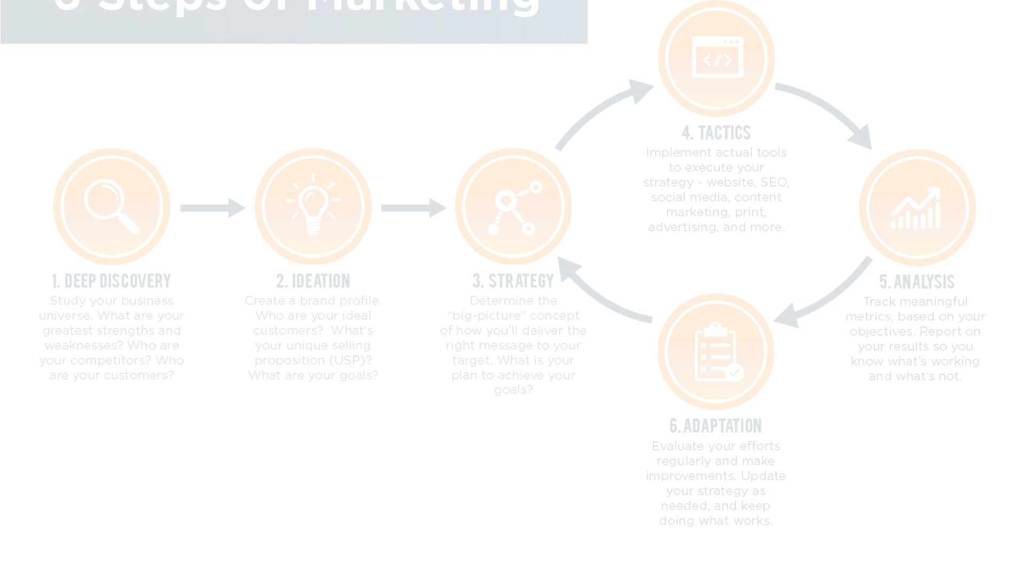
Goals of CLV for Businesses
1
Predict Future CLV
2
Identify Profitable Customers
3
Optimize Marketing Budget
Calculate and predict future CLV to determine how much revenue can be expected from each customer.
Analyze customer characteristics to identify the most valuable, high-CLV customers.
Take marketing actions based on CLV analysis to allocate the marketing budget more effectively.

Slide 3
Optimizing CLV: A Fashion Brand Example
College Students
Working Professionals
Conclusion
Cost to acquire: $10 per customer
Cost to acquire: $20 per customer
The working professionals segment, despite higher acquisition cost, promises a higher ROI due to higher lifetime value.
Average purchase: $100
Average purchase: $100
High churn rate, one-time purchases
Higher repeat purchase rate, $400 lifetime value

Slide 4




Measuring and Analyzing CLV
Frequency/Recency
Probability Models
Visualization
Easy Integration
Visualize CLV, frequency/recency, and other customer behavior insights.
Seamlessly integrate CLV analysis into existing Python workflows.
Analyze customer transaction patterns to understand purchase frequency and recency.
Use probabilistic models like BG/NBD and Gamma-Gamma to predict future CLV.

